Slide 1
NACARA
2016 Annual Conference
Madison, WI
Andy Madden
Director State Government Affairs
October 12, 2016
Advocacy ■ Training ■ Legal Support ■ Member Services

Slide 2
About ACA International
Founded in 1939
3,500 member organizations
40 State Units representing all 50 states
International Unit representing 60+ countries
4
© 2014 ACA International. All Rights Reserved.

Slide 3
A majority of members are small businesses
48% of ACA members less than 9 employees
86% have fewer than 50 employees.
Provide essential services to other small companies.
44% of ACA members report that 50 – 100% of their clients are small business clients.

Slide 4
Legislation
46 states convened legislative sessions in 2016
All 50 States will hold legislative sessions in 2017
Tracking 350+ bills across the country
42 States had some form of legislative activity impacting the credit and collection industry

Slide 5
Legislative Highlights:
Florida - FCA working to create a clear process for consumers to provide notice of attorney representation.
Illinois - ICA worked closely with legislature to fix FDCPA conflicts created when the Illinois Collection Agency Act was extended in late 2015
Wisconsin - Worked with the legislature and administration to pass a bill to allow remote employees
Kentucky - Bill gained would have prevented creditors from sharing any cell phone numbers with their third-party collection agencies or the use of cell phone scrubbing databases.
Maryland - MACA worked closely with AG and Leg Committees and supported legislation which made changes to documentation requirements for filing suit and the statute of limitations.
Pennsylvania - Bill introduced to limit collection calls to 3 times for life of the debt

Slide 6
Other Highlights
Alaska - Updated penalties section
Connecticut - New Connecticut Student Loan Servicer License went into effect July 1, 2016
Idaho - Major improvements to Collection Agent Filling Process
Montana - Requires License for Consumer Loan Collections
North Carolina - Updated branch office, permit and bond requirements
New Jersey - Statute of Limitations reduced to 4 years for collections of retail credit card debt
Virginia - Changes to interest rates on an overdue balance for residential leases
© 2016 ACA International. All Rights Reserved.

Slide 7
Hearings on the Future of Debt Collection Regulations
Maryland
Governor Hogan and the Commissioner of Financial Regulation
Forum for Maryland Collection Agency Licensees
September 22, 2016
Massachusetts
Division of Banks (Division) and Office of the Attorney General
Joint informational session
September 22, 2016
© 2016 ACA International. All Rights Reserved.

Slide 8
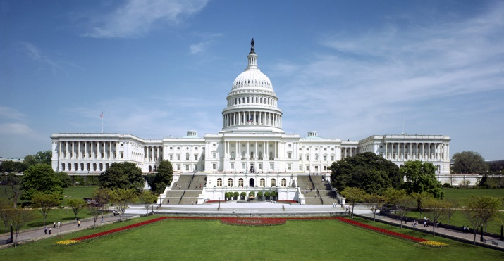
Federal Activity

Slide 9
CFPB Debt Collection Rulemaking
The CFPB released its outline of proposals for the debt collection industry on July 28, It is very wide in scope.
Information Integrity (Substantiation, Review and Transfer of Information, Purchased Debt, Validation Notices)
Disclosures regarding litigation and time barred debt).
Collector Communication Practices (Messages, Content, Contact Frequency)
The industry is very hopeful for three major outcomes of the federal rulemaking - Increased clarity, opportunity for more uniformity, and modernization recognize new technology..
Clear uniform laws that meet consumers changing preferences will benefit creditors, collectors and consumers alike.
The rulemaking will provide a unique opportunity to deliver much needed clarity, uniformity and modernizing.

Slide 10
CFPB Debt Collection Rulemaking
Balance must be struck between protecting consumers and ensuring a vibrant debt collection market.
Legitimate and effective two-way communication must be fostered, not hindered.
Rules must reflect the interaction between various players in the collection and credit cycle.
A flexible framework is crucial to accommodate differences in the debt collection market.
Maximum clarity in new debt collection rules is essential.
Outdated, unnecessary or unduly burdensome legal requirements under the federal FDCPA should be addressed in the rulemaking to create certainty and consistency.

Slide 11
Advancing Technology/ Changing Consumer Preferences
Hindering two-way communication between collectors and consumers to discuss debt resolution options exposes consumers to long-term harm by increasing the likelihood of litigation to recover the outstanding debt.
Debt collectors, if expressly authorized by regulation, would welcome using technology to communicate with consumers, including the use of email, text messages, web portals, social media, instant messaging, wireless telephones and devices, and other modern means.

Slide 12
FCC / TCPA
Pew Research Internet Project over 90% of adult Americans have a cellphone or smartphone but it is very hard for a collector to communicate with a consumer on a cell phone.
As smartphones have become more popular in the United States, landline phones are vanishing. According to data from the Center of Disease Control and Prevention, ten years ago, 9 in 10 households had an operational landline phone.
During the second half of 2015 nearly one-half of American homes (48.3%) had only wireless telephones (cellphone/smartphone). This number is only growing.
More than two-thirds of all adults aged 25-34 and of adults renting their homes were living in wireless-only households.

Slide 13
FCC / TCPA
July 10, 2015 released TCPA Omnibus Declaratory Ruling and Order.
ACA International filed a lawsuit. Consolidated with 9 other entity actions.
Oct. 19 - Oral Arguments before the United States Court of Appeals for the District of Columbia Circuit.

Slide 14
FCC / TCPA
Bipartisan Budget Act of 2015 - Directs FCC to implement rules to exempt autodialed calls “made solely to collect a debt owed to or guaranteed by the United States”
FCC issued final rules on August 11, 2016.
Rules only apply to calls initiated through an automatic telephone dialing system for the purpose of collecting debts owed to the federal government without the consumer’s prior express consent.

Slide 15
Unintended Consequences
Laws that had the best intentions of protecting consumers are now preventing consumers from receiving important financial information. It is time to update laws and embrace advancing technology.
Attempts to limit communication between collectors and consumer ultimately hurt the consumer. If a consumer does not hear about a debt it does not go away. It only escalates… credit reporting, added fees, legal action.
There seems to be a frequent push to further shorten the statute of limitations for debt collection.
If enacted creditors may choose to forego third party collection and begin to pursue legal action against a debtor more frequently or decide to go the legal route much earlier in the collection process.
Many agencies are able to set up payment plans with debtors that can only afford to pay minimum amounts each month? The proposal could inhibit an agency’s ability or the consumer’s ability to set up payment plans on debt that may be closing in on the statute of limitations?

